Slide 1

Introduction – CSS
27. februar 2018

Slide 2

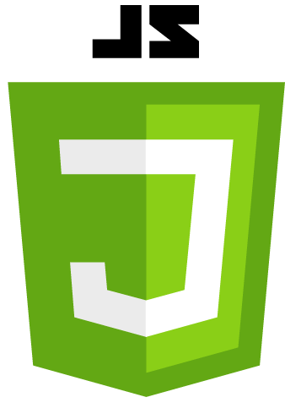




What is a website?
Notes:
Explain all parts

Slide 3
What is a website?

Slide 4
HTML – HyperText Markup Language
Defines the structure of a webpage
CSS – Cascading Style Sheet
Defines the visual presentation of HTML elements
JS – Javascript
Handles user interaction and dynamic content

Slide 5
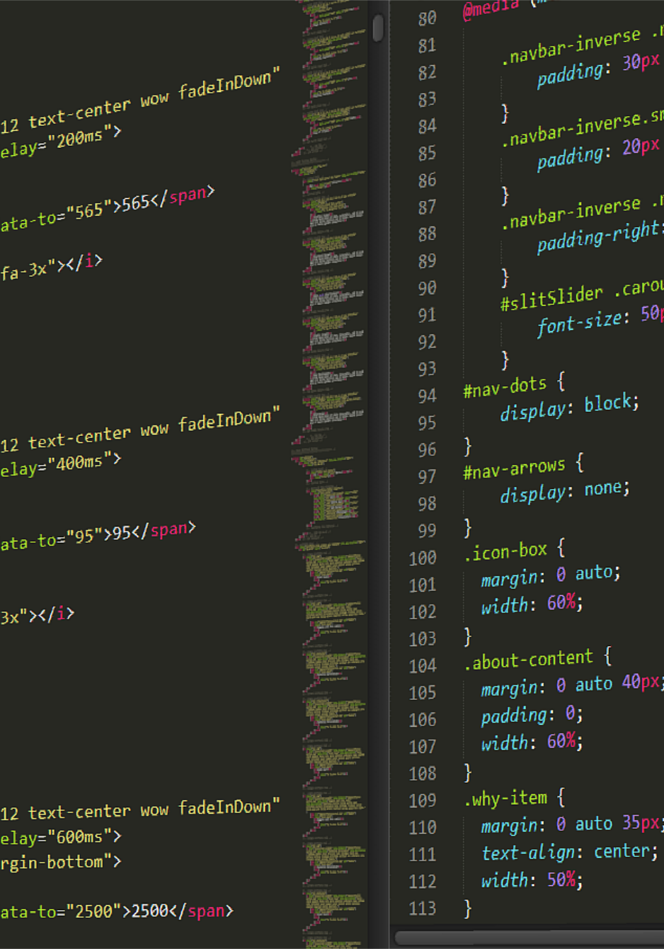
Cascading Style Sheets

Slide 6
The Stylesheet
A stylesheet is a set of rules defining how an HTML element will be presented in a browser.
These rules are targeted to specific elements in an HTML document

Slide 7
The Cascade
The cascade part of CSS is a set of rules for resolving conflicts.
Conflicts arise when multiple CSS rules are defined for a given element.
Example:
If there are two rules defining the color of your <h1> elements,
the rule that comes last in the cascade will trump all other rules.

Slide 8
Order of importance
Browser stylesheet
Linked (external) stylesheet
Embedded (internal) stylesheet
Inline (internal) styles
Low importance
High importance

Slide 9
Inheritance
Most elements will inherit some style properties from their parent elements by default
body
Make paragraph 16px, Verdana and red
p
Make paragraph blue
content
16px, Verdana, blue

Slide 10
Specificity
Shortly after styling your first HTML elements, you will find yourself wanting
more control over where your styles are applied
This is where specificity comes into play
Specificity refers to how specific your selector is in naming an element

Slide 11
Specificity (cont.)
body
Make paragraph 16px, Verdana and red
p
Make paragraph blue
content
16px, Verdana, pink
p.pink
Make paragraph pink

Slide 12
Syntax
CSS Rule
CSS Selector
CSS Declaration

Slide 13
CSS Rule
selector {
property: value;
}
Every style is defined by a selector and a declaration.
The declaration contains at least one property/value pair.
Together they form a CSS Rule.
Notes:
Selector → Refers to a tag, class name or id
Property → Some styling property, i.e. width, height etc.
Value → The given value to the property

Slide 14
CSS Selector
The CSS Selector associates css rules with HTML elements
The selector is typed in front of the declaration
Example:
p {
text-color: red
}
Typically extra space indentations and line feed are added for readability

Slide 15
CSS Declaration
The declaration is always defined as a property/value pair.
The two are separated by a colon and with a semi-colon.
How you define these pair, determines how your HTML elements are displayed.

Slide 16
Selectors
p Type (element)
# ID reference
. Class reference

Slide 17
Type (element) selectors
The simplest selector is the type selector.
This selector targets html element by name.
body { declaration }
p { declaration }
h1, h2 { declaration }
ul { declaration }

Slide 18
ID Selectors
An ID is an html attribute.
It can be added to all HTML elements.
You then reference that ID in your CSS with a #
#logo { declaration }
<img id=”logo” src=”…” alt=”…” />

Slide 19
Class selectors
A class is an HTML attribute
It can be added to all HTML elements
You reference the class with a period.
.small-image { declaration }
<img id=”logo” class=”small-image” src=”…” alt=”…” />

Slide 20
Examples
body {
background-color: #ff00ff;
}
h1.header, h2 {
text-align: center;
font-size: 32px;
font-weight: bold;
}
#logo {
text-color: #6F6F6C
}

Slide 21
IDs vs. Classes
The most important difference is that IDs are unique on a per page basis.
Whereas classes can be defined multiple times.
Classes can be used to style multiple elements in a common way
Ids can be used to style a specific unique element.
ID is more specific than a class
An element can have one ID and multiple classes

Slide 22
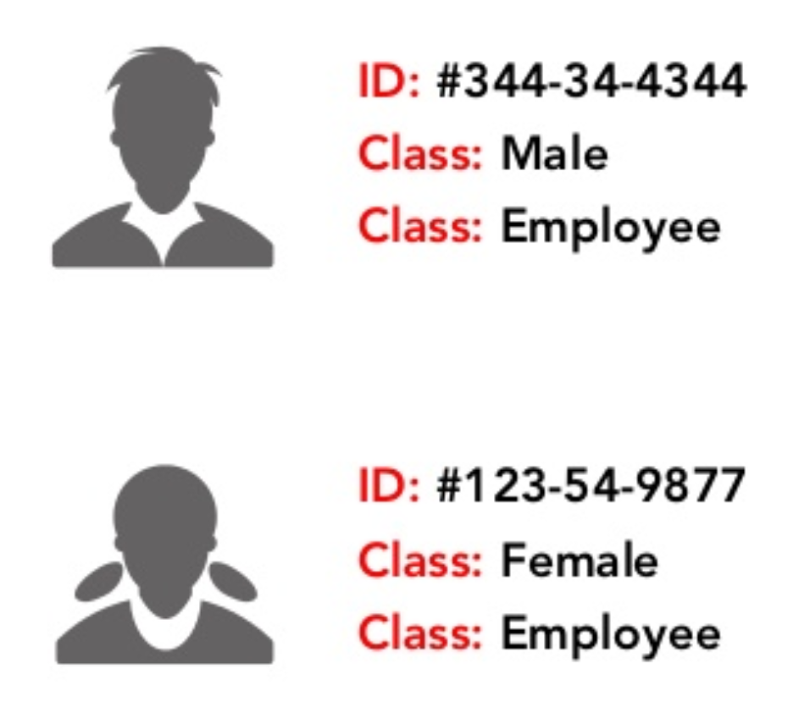
IDs vs. Classes (cont.)

Slide 23
Descendant selectors
CSS
#sidebar h1 .author { declaration }
HTML
<div id=”sidebar”>
<h1>
<span class=”author”>…</span>
</h1>
</div>
A space between selectors indicates a descendant selector.
The above style targets the span with the author class.

Slide 24
Descendant selectors (cont.)
CSS
#sidebar h1 .author.important { declaration }
HTML
<div id=”sidebar”>
<h1>
<span class=”author important”>…</span>
</h1>
</div>
Elements can have multiple classes, giving more granular control.
They are written in CSS in the exact order in which they appear in the HTML

Slide 25
Adding styling
Inside <style> tags
<style>
div, p {
text-color: #6F6F6C
}
</style>
On an element
<p style=”color: #6F6F6C;” >

Slide 26
Referencing a css file
Or reference an external CSS file…
<link href=”/path/to/file/file.css” rel=”stylesheet” type=”text/css”/>
Place it in the <head>
This is the right way!

Slide 27
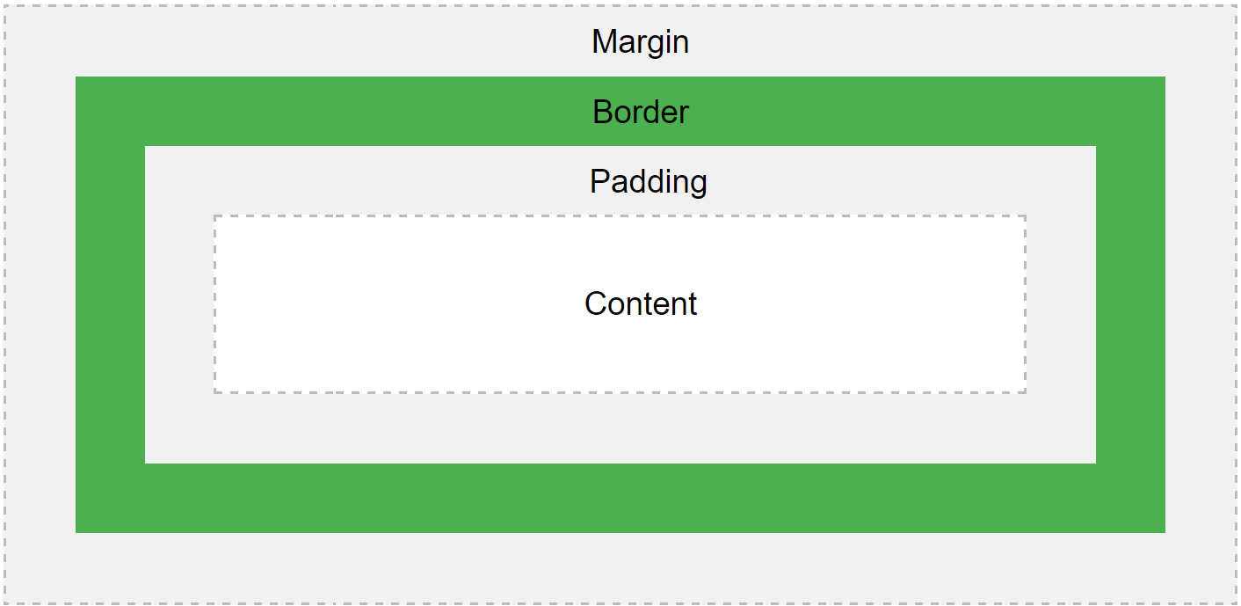
CSS Box Model
Content
- The content of the box, where text and images appear
Padding
- Clears an area around the content. The padding is transparent
Border
- A border that goes around the padding and content
Margin
- Clears an area outside the border. The margin is transparent
Notes:
Box Model → All elements have them

Slide 28
Placement
display: inline;
display: block;

Slide 29
Placement (cont.)
Img {
float: right;
}
Img {
float: right;
}
Img {
float: right;
}

Slide 30
Positioning
position: relative;
bottom: 40px;
position: absolute;
bottom: 20px;
position: relative;
bottom: 40px;
position: absolute;
bottom: 20px;

Slide 31
Positioning (cont.)
position: absolute;
bottom: 20px;
position: relative;
position: absolute;
bottom: 20px;
position: relative;

Slide 32
Demo time

Slide 33
Exercise → Style your Google web page to look more like the real thing

Slide 34


Slide 35
Steps
Create an account on codecademy.com (You should have done that)
Start the course ”Learn CSS”
Complete the following:
CSS Fundementals
This course should teach everyone without any prior knowledge, the fundementals of HTML and CSS.

Slide 36

CSS Grid

Slide 37
Preparation
Download Mozilla Firefox Developer Edition (also known as Firefox Quantum)
It has an awesome grid inspector!

Slide 38
Pretext
Web layouts are broken
We’ve basically just refined how we break them
Flex box fixed a lot of issues
Lots of markup consisted of wrappers within wrappers

Slide 39
Problem and solution
Problem:
Current tools for web
layout is content-out
and one-dimensional
Solution:
Two-dimensional layout-in
tool to separate content
from presentation

Slide 40
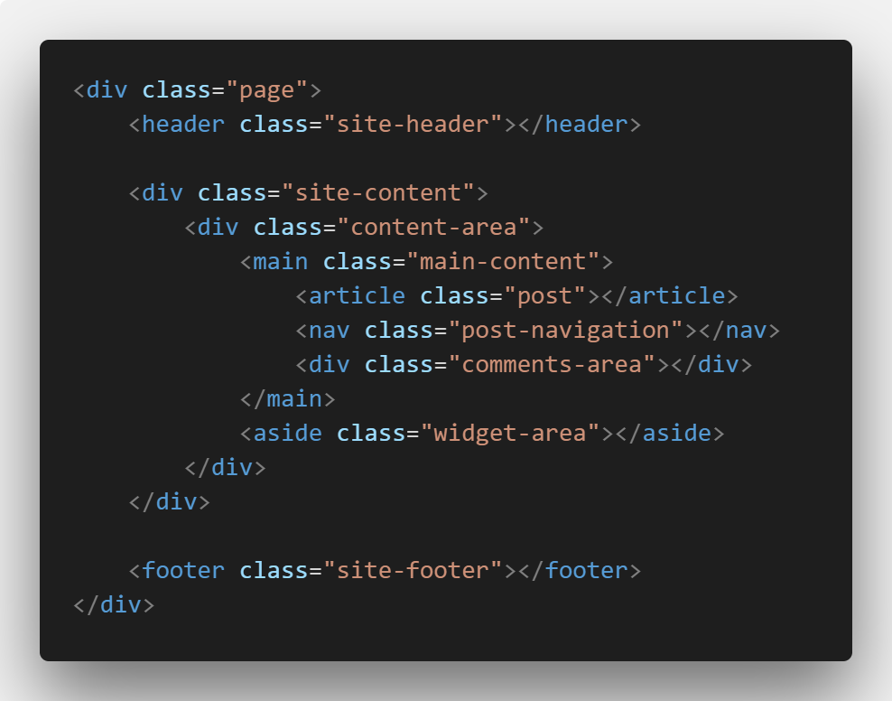
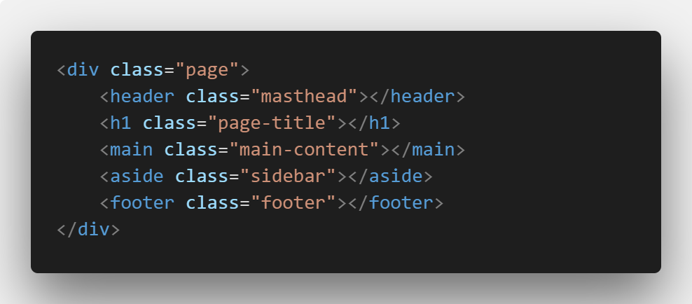
A griddy approach
Instead of relying on multiple wrappers,
we instead rely of defining the space each element will occupy.

Slide 41
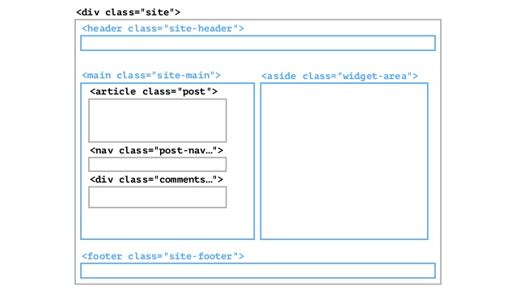
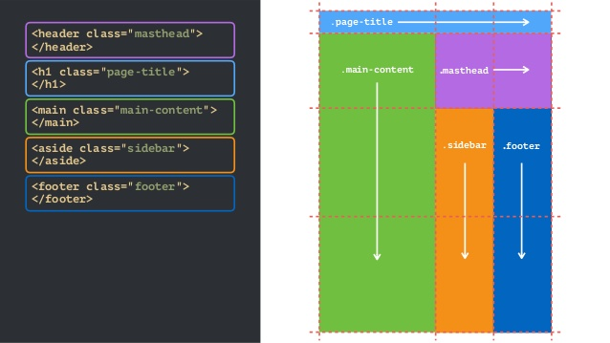
A griddy approah (cont.)

Slide 42
Grid terminology
Grid container
Grid item
Grid line
Grid cell
Grid track
Grid area
Grid gap

Slide 43
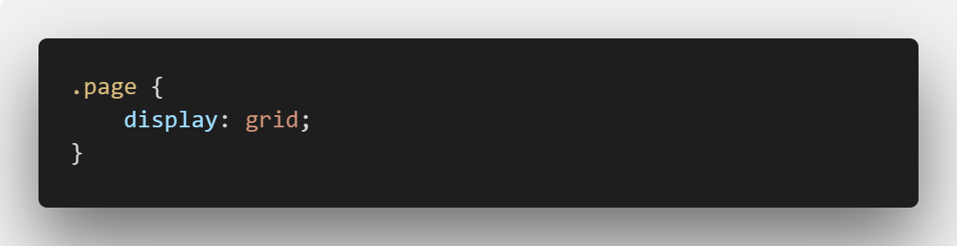
Grid container
An element containing a grid is denoted by display: grid;

Slide 44
Grid item
Element that is a direct descendant of the grid container

Slide 45
Grid line
A grid consists of Rows and Columns
Rows are horizontal
Columns are vertical

Slide 46
Grid line
1
2
3
4
5
6
1
Grid lines are referenced by number
Starting and ending with outer borders
2
3
4
5
6

Slide 47
Grid cell
1
2
3
4
5
6
1
The intersection between a grid row and a grid column.
Effectively the same as a table cell
2
3
4
5
6

Slide 48
Grid area
1
2
3
4
5
6
1
Rectangular area between 4 specified grid lines.
Grid areas can cover one or more cells.
2
3
4
5
6

Slide 49
Grid track
1
2
3
4
5
6
1
The space between two or more adjacent grid lines.
Row tracks are horizontal
Column tracks are vertical
2
3
4
5
6

Slide 50
Grid gap
1
2
3
4
5
6
1
Empty space between grid tracks
Commonly known as gutters
2
3
4
5
6

Slide 51
CSS Grid in a nutshell
Define a grid
Place items in that grid
Make world peace!

Slide 52
Defining a grid

Slide 53
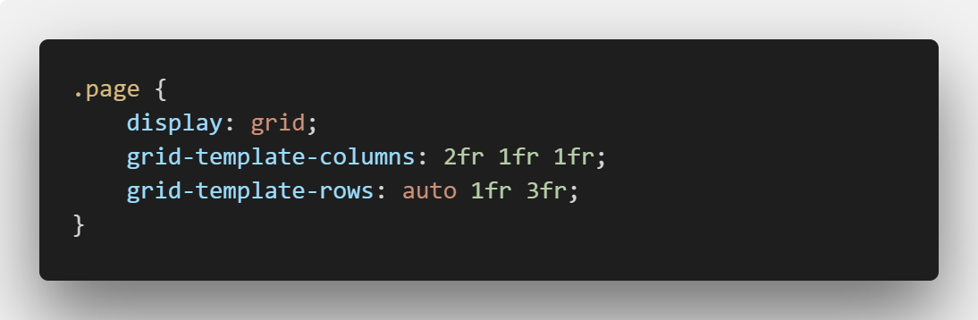
Defining a grid (cont.)

Slide 54
Defining a grid (cont.)
.masthead | .page-title | .main-content
.sidebar | .footer
Grid items are automatically placed in the grid
It is populated from the top-left towards bottom-right

Slide 55
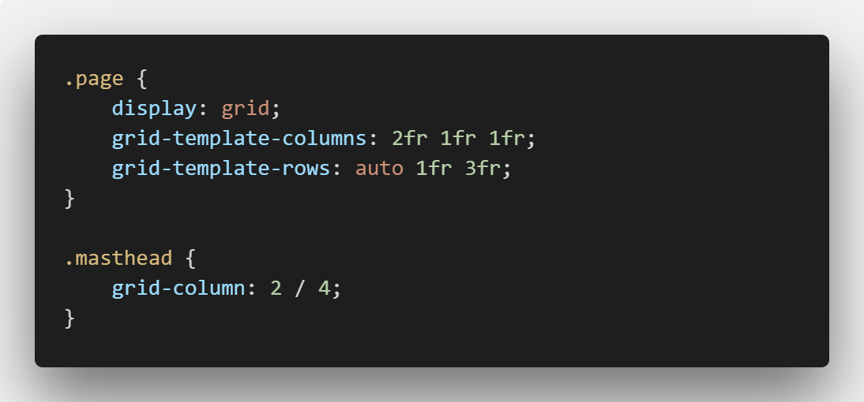
Defining a grid (cont.)
 | .masthead
Start at column line 2
End at column line 4

Slide 56

Defining a grid (cont.)
 | .masthead
Start at row line 2
End at row line 3

Slide 57
Exercise
Copy html:
Copy Css:
Place elements according to the grid.
Put some content inside each element to verify the placement
.page-title
.main-content | .masthead
 | .sidebar | .footer

Slide 58
Looks promising!
BUT
Remembering different lines is difficult!
Especially if the site is responsive.

Slide 59

What is responsive?

Slide 60
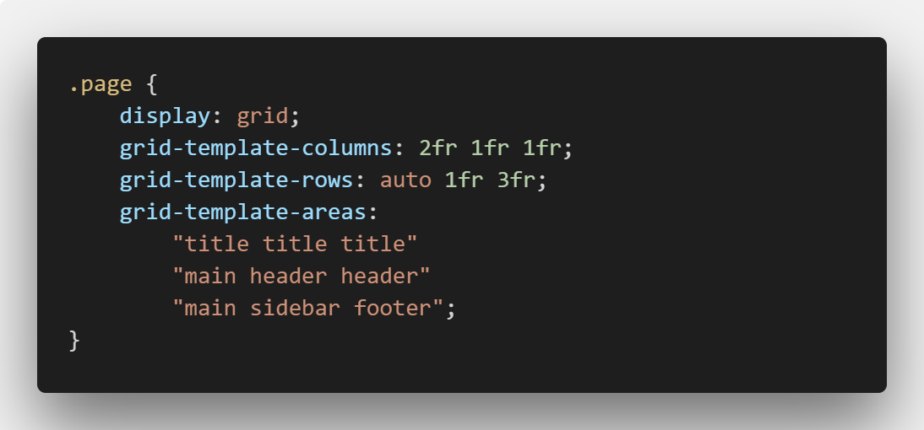
Grid Template areas
title | title | title
main | header | header
main | sidebar | footer

Slide 61
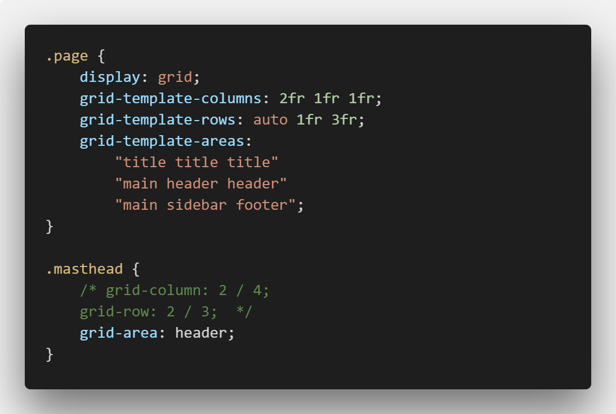
Grid Template areas
title | title | title
main | header | header
main | sidebar | footer

Slide 62
Exercise
Rewrite the previous grid to use Grid Template areas instead of Grid row and column line definitions.

Slide 63

Responsive web design using Grid

Slide 64
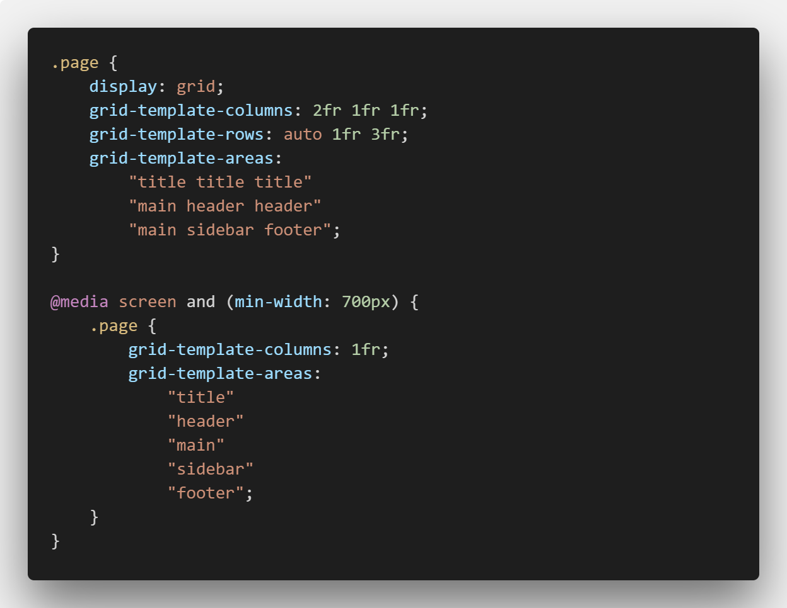
Media queries

Slide 65
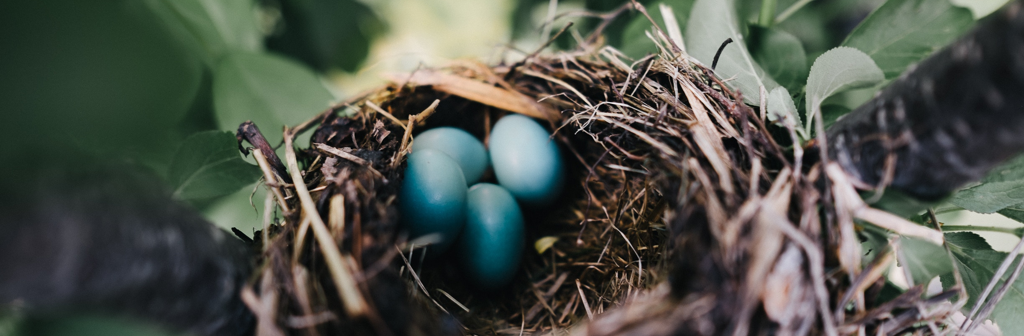
Nesting

Slide 66
Nested Grids
Grids are not inherited
Therefore we create grids within grids
This is called nested grids

Slide 67
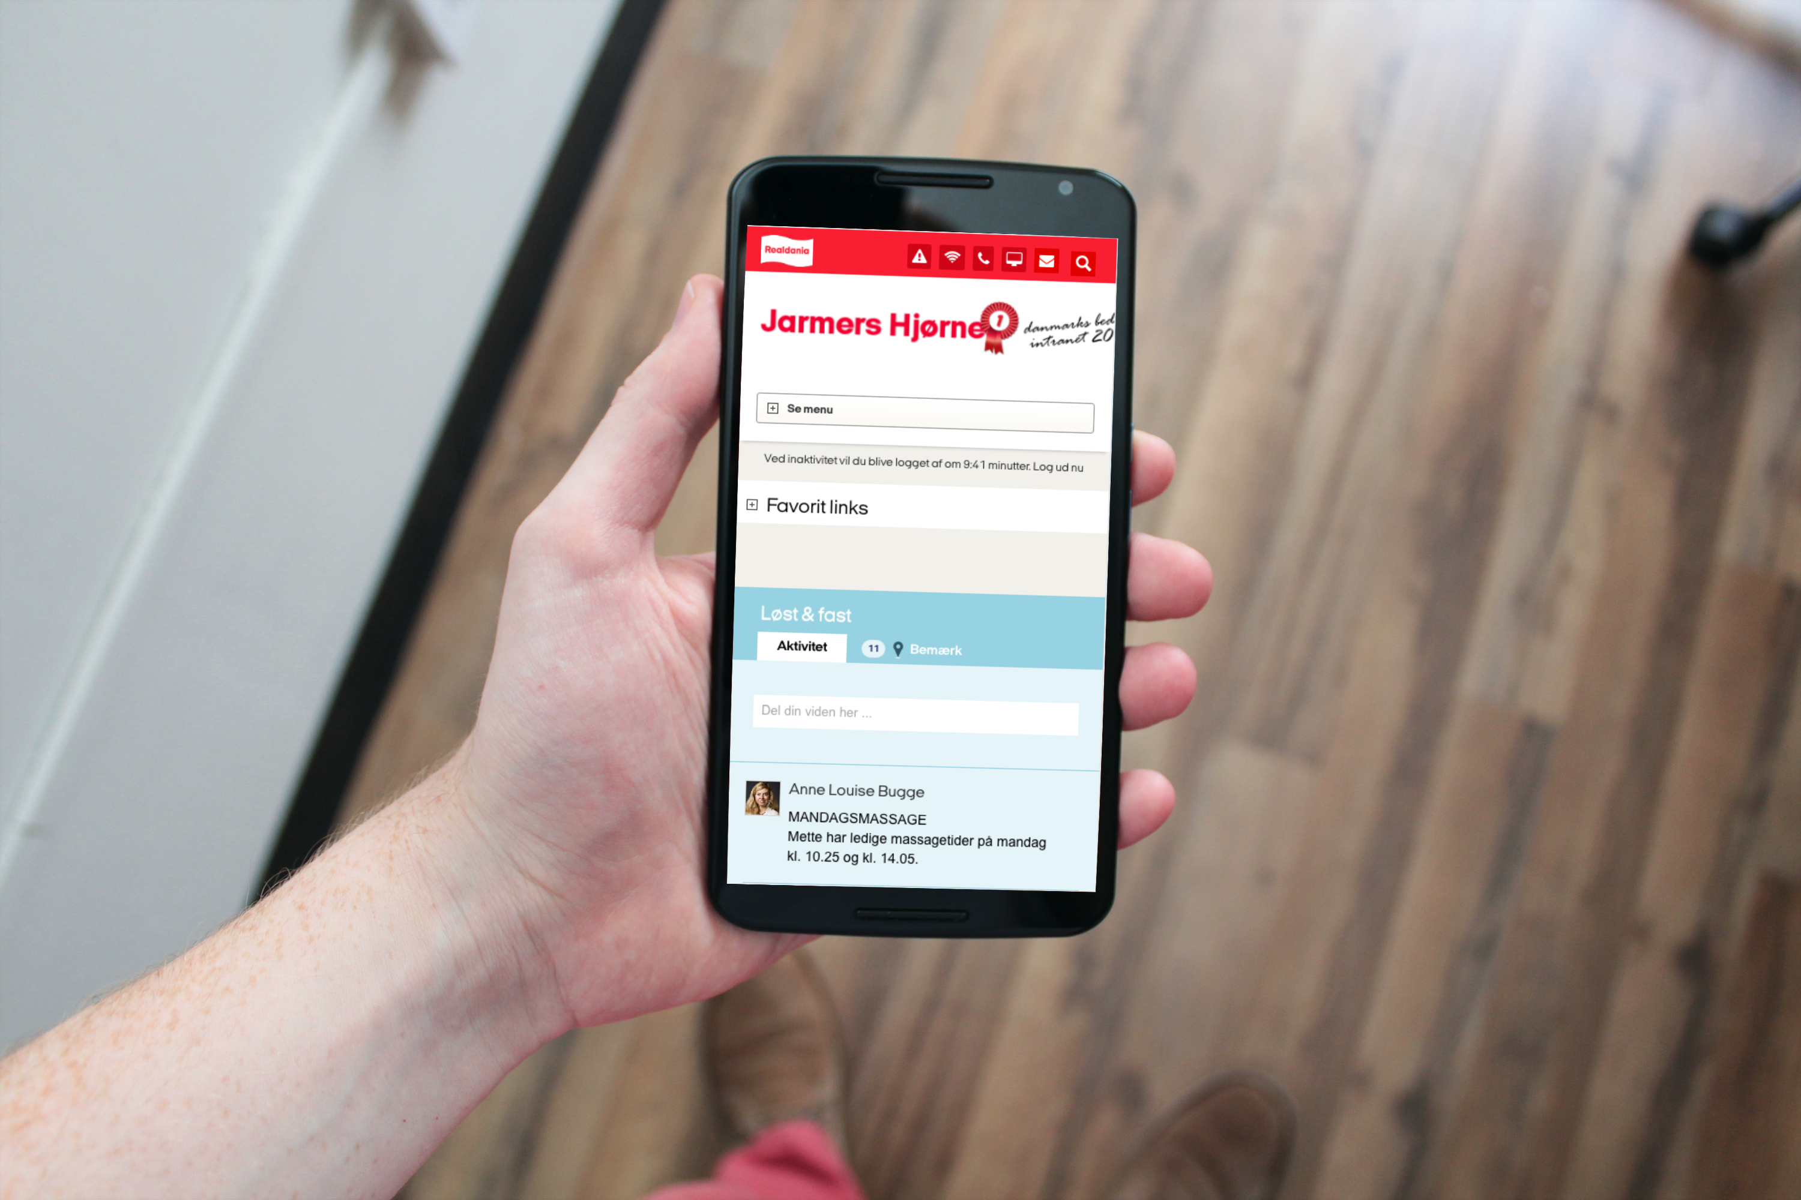
Questions?

Slide 68

Brugbare elementer
Dobbeltklik for at ændre farve eller indsætte baggrundsbillede

